Slide 1
QUIZ APPLICATION
TS- WEB/CC/AI TRACK CAPSTONE PROJECT
Presented By:
1. B.HARSHITHA
2. D.VARSHITHA
3. D.SAI PRANATHI
4. A.VEENA
Guided By:Hrishikesh Mahure

Slide 2
OUTLINE
Abstract
Problem Statement (Should not include solution)
Aims , Objective & Proposed System/Solution
System Design
System Development Approach(Technology Used)
Algorithm & Deployment
Sample Screenshot
Conclusion
References
Future Scope

Slide 3
Abstract
“Quiz Application” is a collection of different quizzes like
technical,general knowledge,English Grammer,Quantitative Aptitude.
User can access only one quiz at a time.
There will be a limited number of questions and for each correct answer
user will be get a credit score.
To develop a user friendly application,our application will contain:
1.Number of quiz
2.Answer to every question
3.Feedback

Slide 4
Problem Statement
“Our aim is to develop a application for the users in which a user can attempt any number of quiz related to his/her choice”
Firstly we have to make interface for home page,registration,login page,question attempting forum,result page and profile of user and as well as for admin.These all pages have connectivity with the server and database.
Currently,there are websites which only provide limited number of quizzes related to different domains.
Many websites donot have single platform for quizzes related to technical,GK,aptitude,grammer etc,.
We have to develop a app which can resolve all problems.

Slide 5
Proposed Solution
In this application firstly the user need to register or login using user-id and password.Then the user can choose any of quiz of his/her choice.
There is a instruction window.User can start attaining the quiz.User can see his/her answers are right/wrong and can also see answer of each.
If there is any feedback he/she can send.
After completion of the quiz user will get credit score for each of its correct answers.Admin will submit question,after submission of 10 questions in each category the quiz list will increase dynamically.
The user profile will contain its name,age,qualification,gender,mobile number,credit score,etc,.

Slide 6
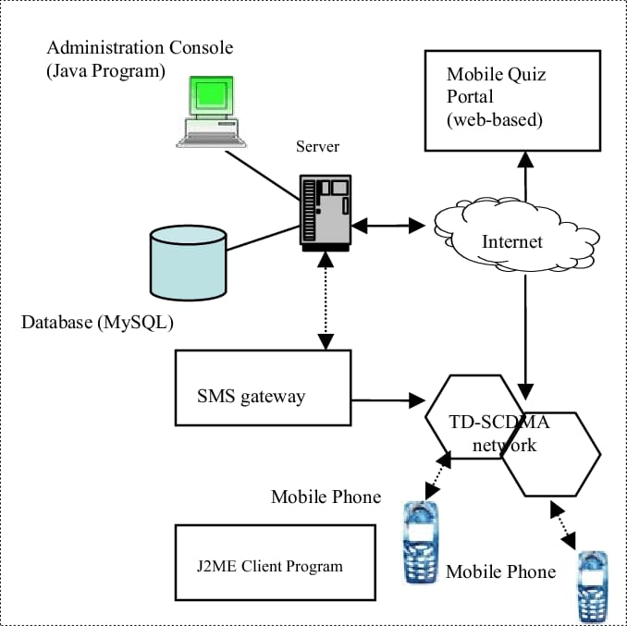
System Architecture

Slide 7
System Deployment Approach
We can use cloud-based deployment,such as utilizing platforms like AWS,Google cloud,Microsoft Azure.
These allows for easy scalability,high availability and reduced infrastructure costs.
The benifits of cloud deployment such as
1.Automatic scalling
2.Load balancing
3.Data redundency
We can also use containerization technologies like docker and container orchestration platforms.

Slide 8
Algorithm & Deployment
Algorithm:
i.Retrive user input
ii.Randomize the order of questions
iii.Present each question to user
iv.Evaluate users answers
v.Calculate and display final score
Deployment:
i.Choose a cloud platforms like AWS,Google Cloud
ii.Setup neccessary infrastructure and resources
iii.Deploy the quiz app on the choosen cloud platform
iv.Configure scalability and high availability options
v.Ensure proper security measures are in place

Slide 9
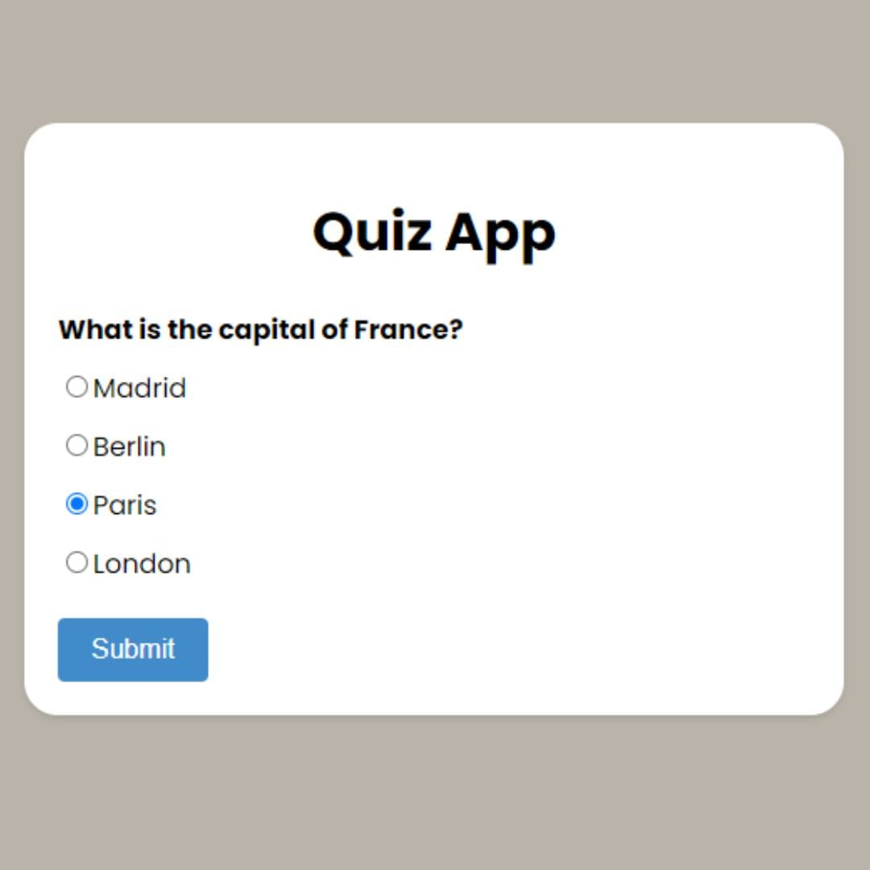
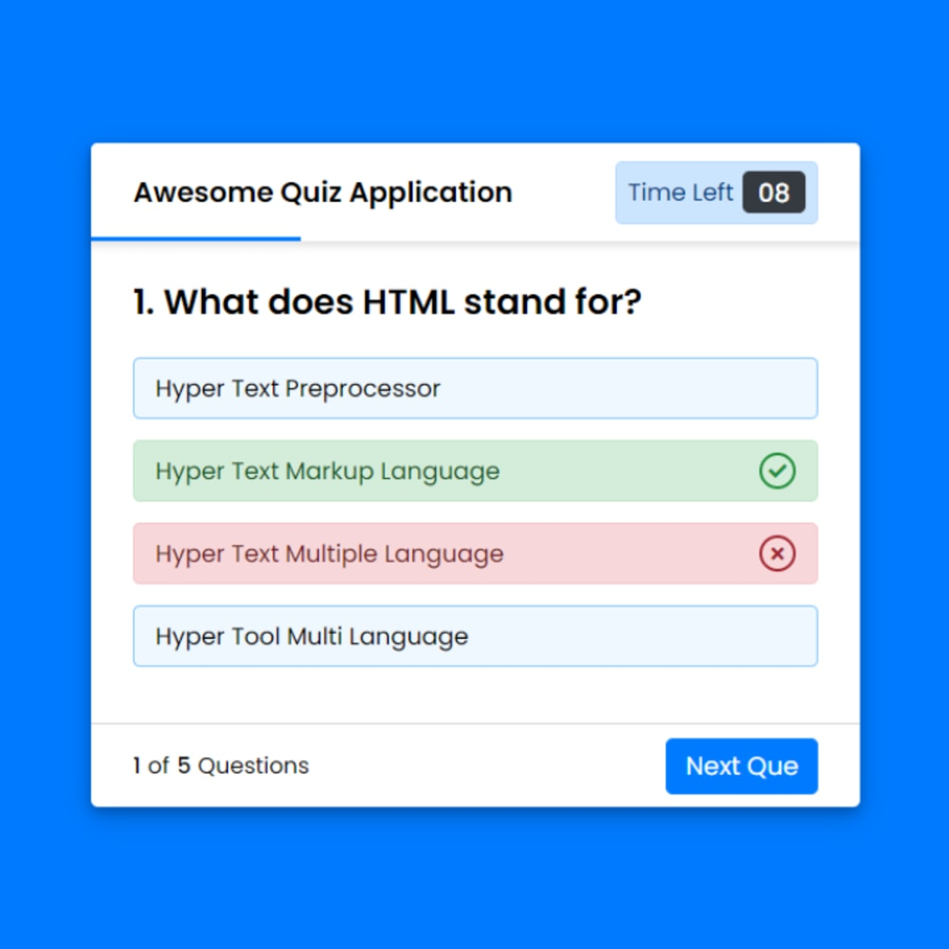
Sample Screenshots

Slide 10
Conclusion
"In conclusion, our quiz app offers a fun and interactive way for users to test their knowledge. With its user-friendly interface and diverse question categories, it's sure to engage and challenge users.

Slide 11
References
1. "Designing Interactive Quizzes: A User-Centered Approach" by John Smith
2. "Mobile App Design: Best Practices for User Experience" by Sarah Johnson
3. "Gamification in Education: How Quizzes Enhance Learning" by Emily Davis
4. "User Interface Design Patterns: Quiz App Edition" by Mark Thompson
5. "The Psychology of Engagement: Designing Addictive Quiz Experiences" by Jessica Roberts

Slide 12
Future Scope
The future scope for designing a quiz app is vast. We can explore incorporating personalized user profiles, social sharing features, and even integrating machine learning algorithms for adaptive question generation. Additionally, expanding the app to multiple platforms and languages can help reach a wider audience. The possibilities are endless, and with continuous updates and enhancements, the quiz app can become a go-to destination for knowledge seekers worldwide.

Slide 13
THANK YOU

